Slide 1

The AI Stack: Architecting Intelligence with LLMs, RAG, and Llama
Moving beyond basic generative AI to build production-ready intelligent systems

Slide 2
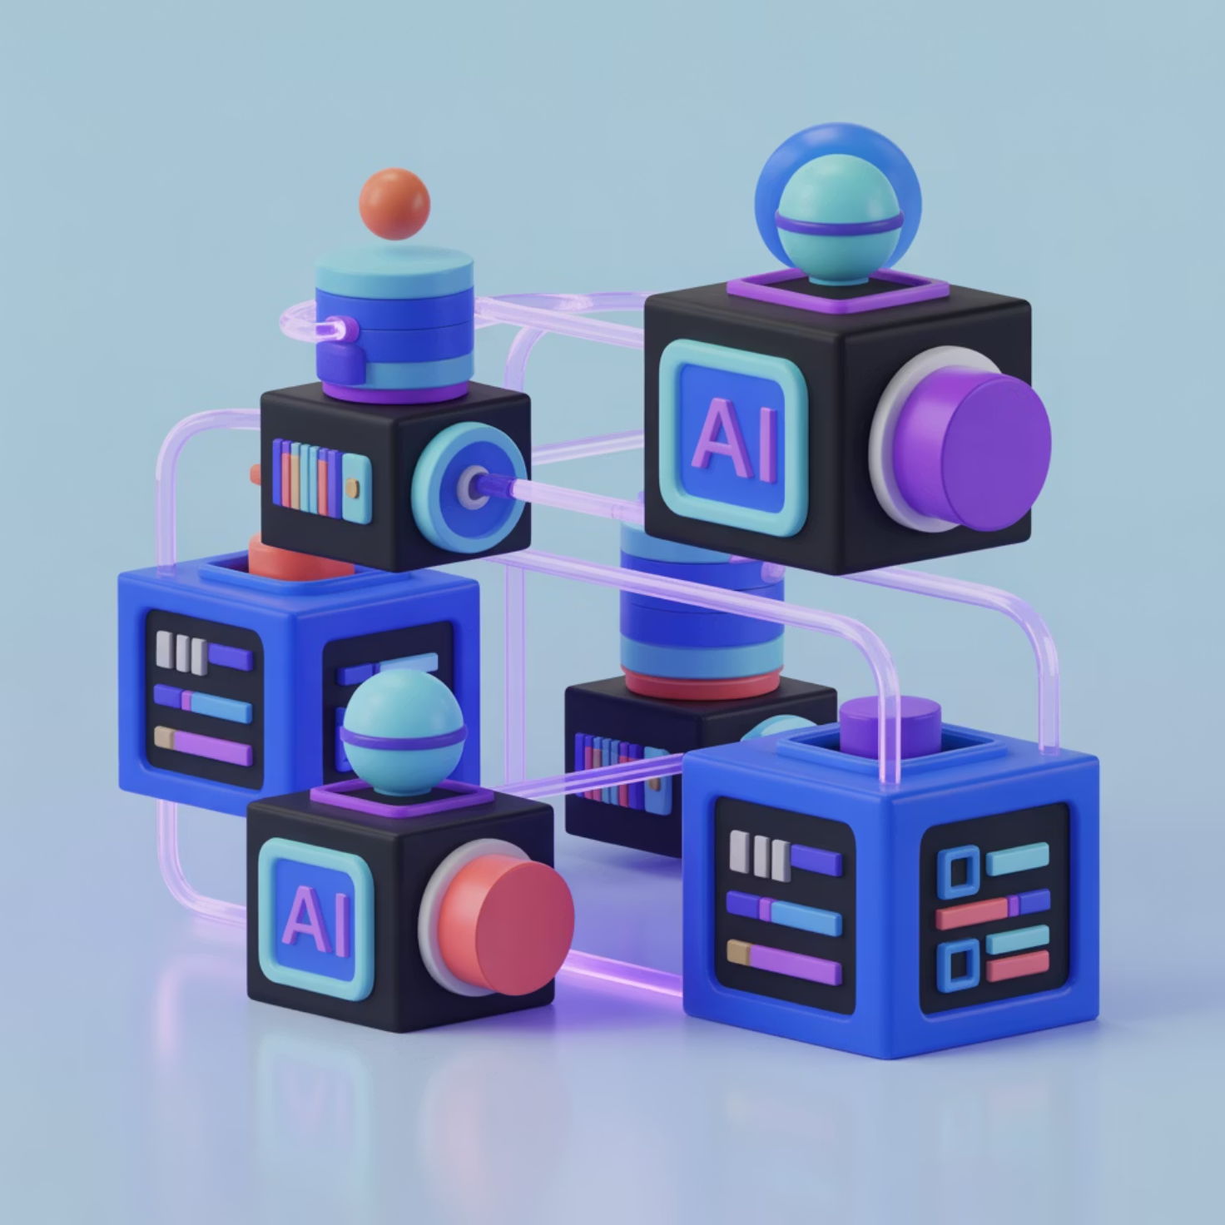
INTRODUCTION
Beyond the Chatbot — The 2026 AI Landscape
The Paradigm Shift
We're transitioning from "Generative AI as a toy" to "Agentic AI as infrastructure" — where AI systems actively orchestrate workflows rather than passively respond to prompts.
Modern AI is Modular
Today's intelligent systems combine foundational models, retrieval mechanisms, and optimization techniques into cohesive architectures.

Slide 3
Today's Technical Roadmap
Foundational Models
Information Retrieval
Interaction Optimization
Understanding Llama 3/4 architecture and the transformer backbone that powers modern language understanding
Implementing RAG (Retrieval-Augmented Generation) to ground AI responses in factual, up-to-date knowledge
Mastering prompt engineering techniques to extract maximum performance from language models

Slide 4


FOUNDATIONAL MODELS
The Engine — Understanding the Llama Family
Meta's Open-Source Powerhouse
Llama leveled the playing field between big tech and independent developers by democratizing access to state-of-the-art language models. This open-source approach enables both privacy-focused local deployment and specialized fine-tuning for niche applications.

Slide 5
Llama Architecture Highlights
Why Open Source Matters
Transformer-Based Core
RMSNorm & RoPE
Privacy: Deploy models locally without sending data to external APIs
Specialization: Fine-tune on domain-specific datasets for industry applications
Cost Control: Eliminate per-token API costs for high-volume use cases
Transparency: Audit model behaviour and understand decision-making processes
Utilizes self-attention mechanisms to process data in parallel, dramatically improving efficiency over sequential models
Rotary Positional Embeddings provide superior understanding of word positioning and relationships within context

Slide 6
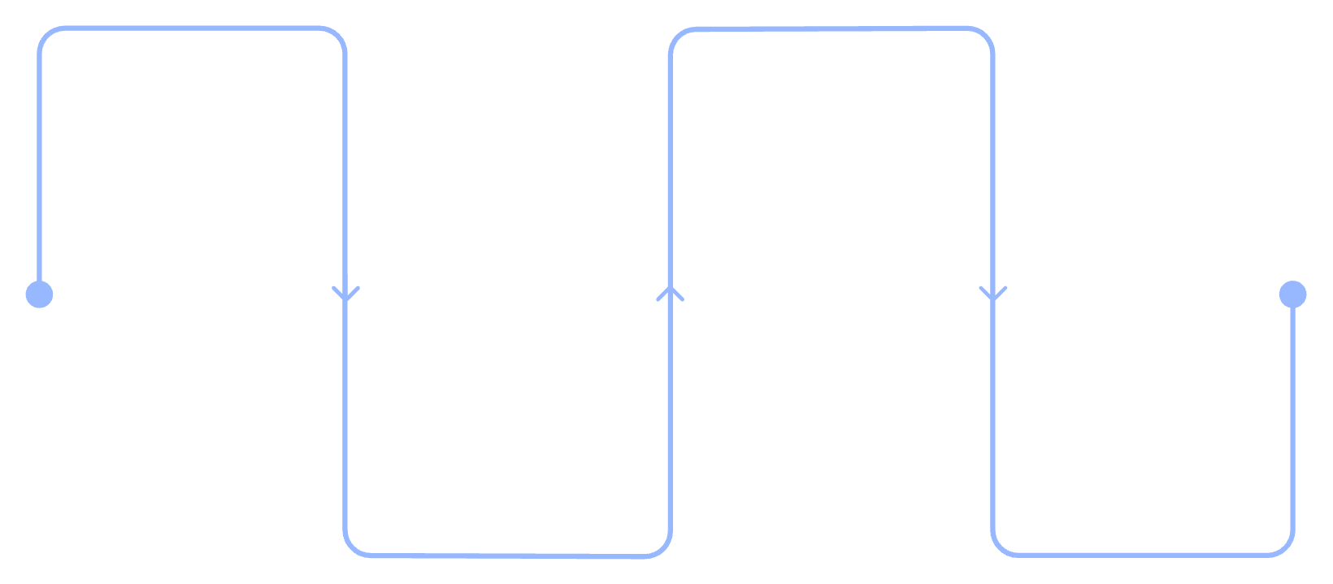
RAG SYSTEMS
RAG: Retrieval-Augmented Generation
The Fundamental Problem
User Query
Context Augmentation
LLMs operate with a training cutoff date and frequently hallucinate — confidently generating plausible-sounding but factually incorrect information. They cannot access real-time data or private organizational knowledge.
Submit a question or prompt
Assemble and refine supporting context
Retrieval
Generation
The RAG Solution
Fetch relevant docs from vector DB
Produce answer using Llama
Instead of relying solely on parametric memory, the model retrieves relevant information from an external knowledge base before generating responses — combining the fluency of LLMs with the accuracy of search.
This architecture ensures responses are grounded in verifiable, current information rather than potentially outdated training data.

Slide 7
RAG vs. Fine-Tuning: Choosing Your Strategy
Feature
Fine-Tuning
RAG (Retrieval)
Analogy
A student studying for months to internalize a new language
A student taking an open-book exam with reference materials
Best For
Changing style, tone, specialized vocabulary, or behaviour patterns
Providing up-to-date facts, private data, and verifiable citations
Cost
High (Requires GPU training infrastructure)
Lower (Requires vector database and embeddings)
Update Frequency
Static (Must retrain entire model to incorporate new knowledge)
Dynamic (Simply upload new documents to the knowledge base)
In practice, the most sophisticated systems combine both approaches — fine-tuning for domain expertise and RAG for factual grounding.

Slide 8
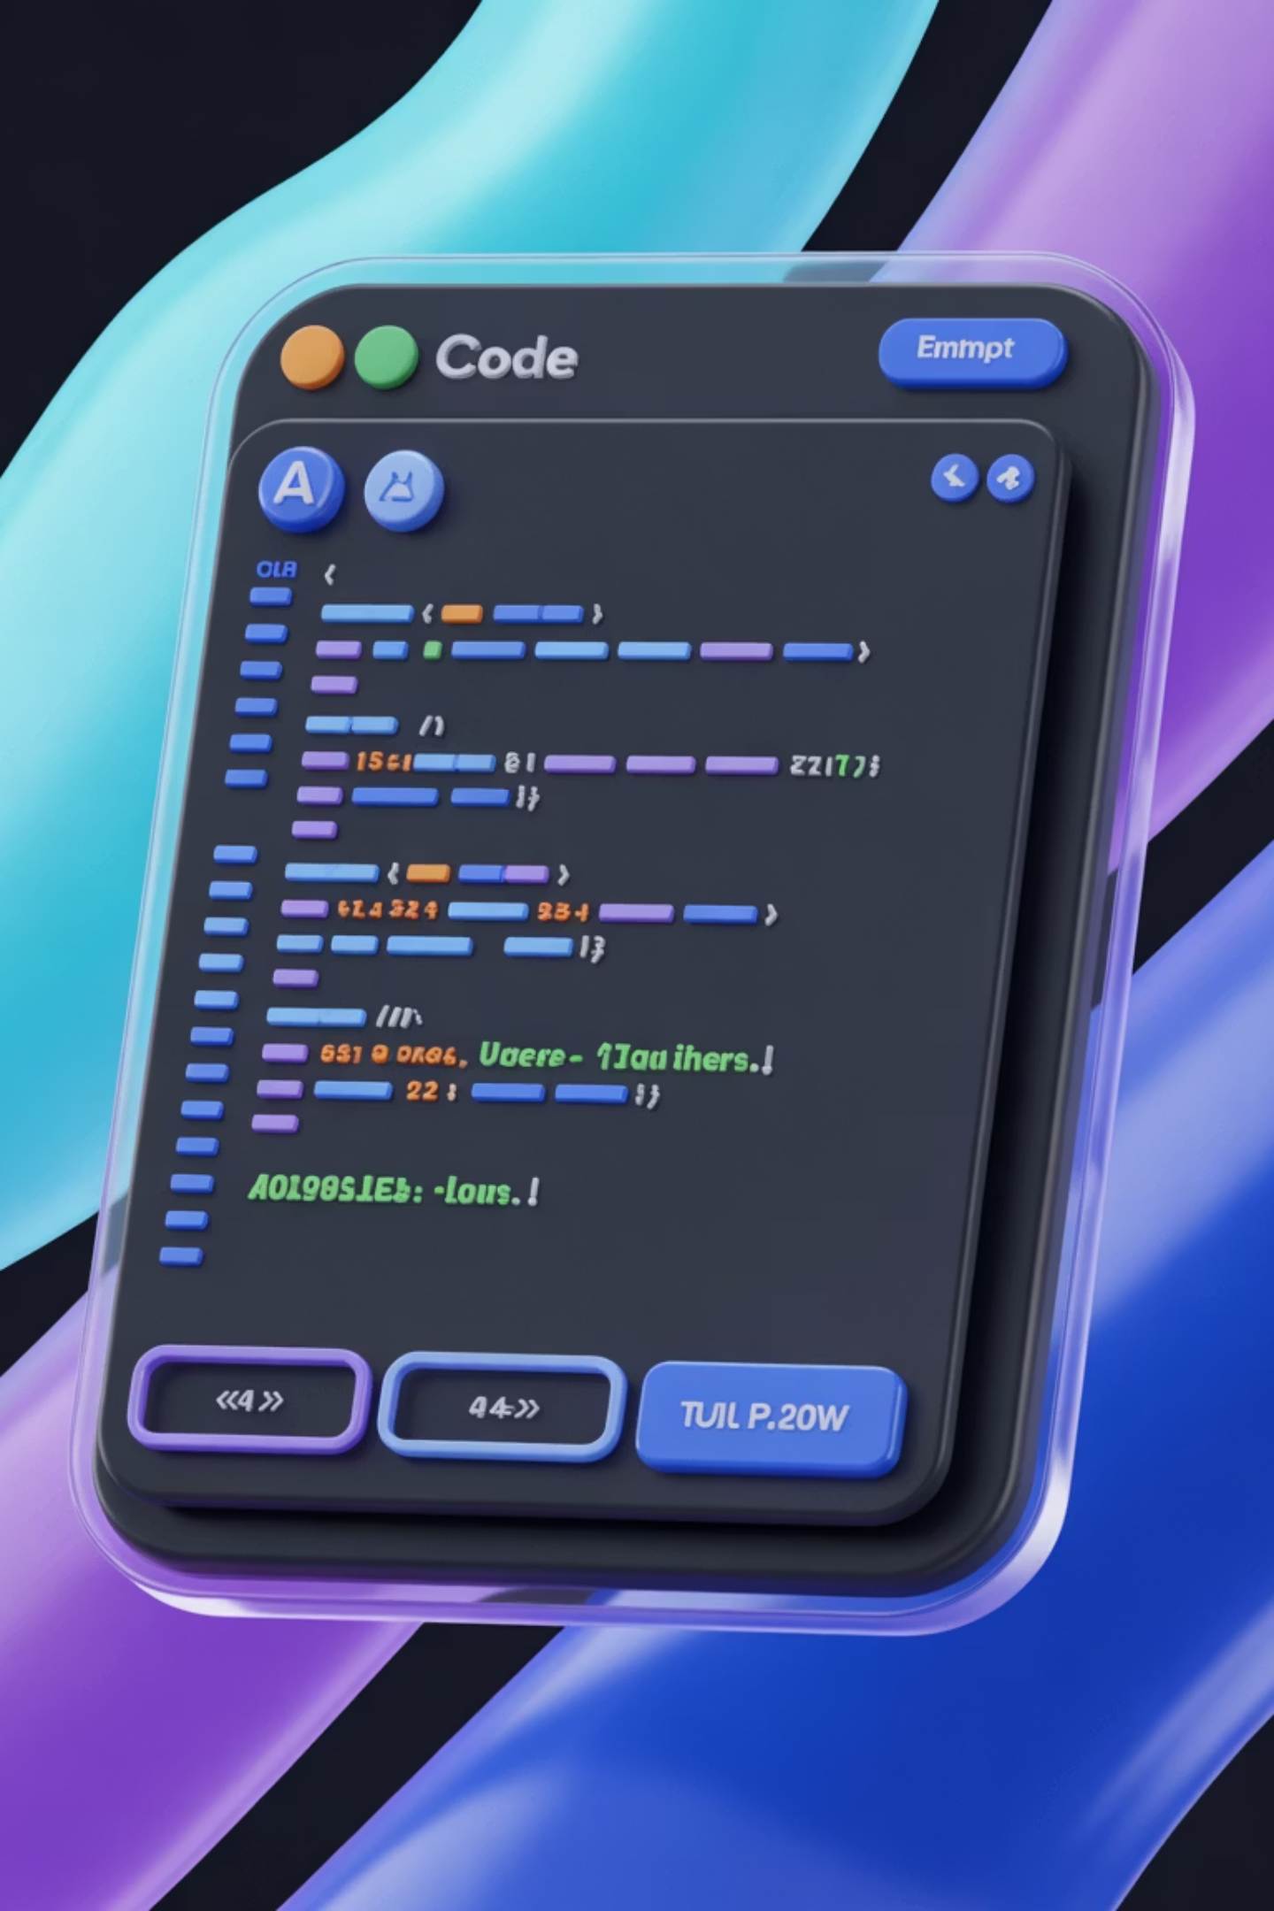




ADVANCED TECHNIQUES
Prompt Engineering 2.0
Few-Shot Prompting
Provide 3–5 examples of desired output format to establish patterns without explicit instructions
Chain-of-Thought
Force the model to reason step-by-step for complex logic and mathematical problem-solving
System Prompts
Define persona and guardrails at the root level to establish consistent behaviour patterns
The Golden Rule: Output quality is a direct function of context window management and information density.

Slide 9
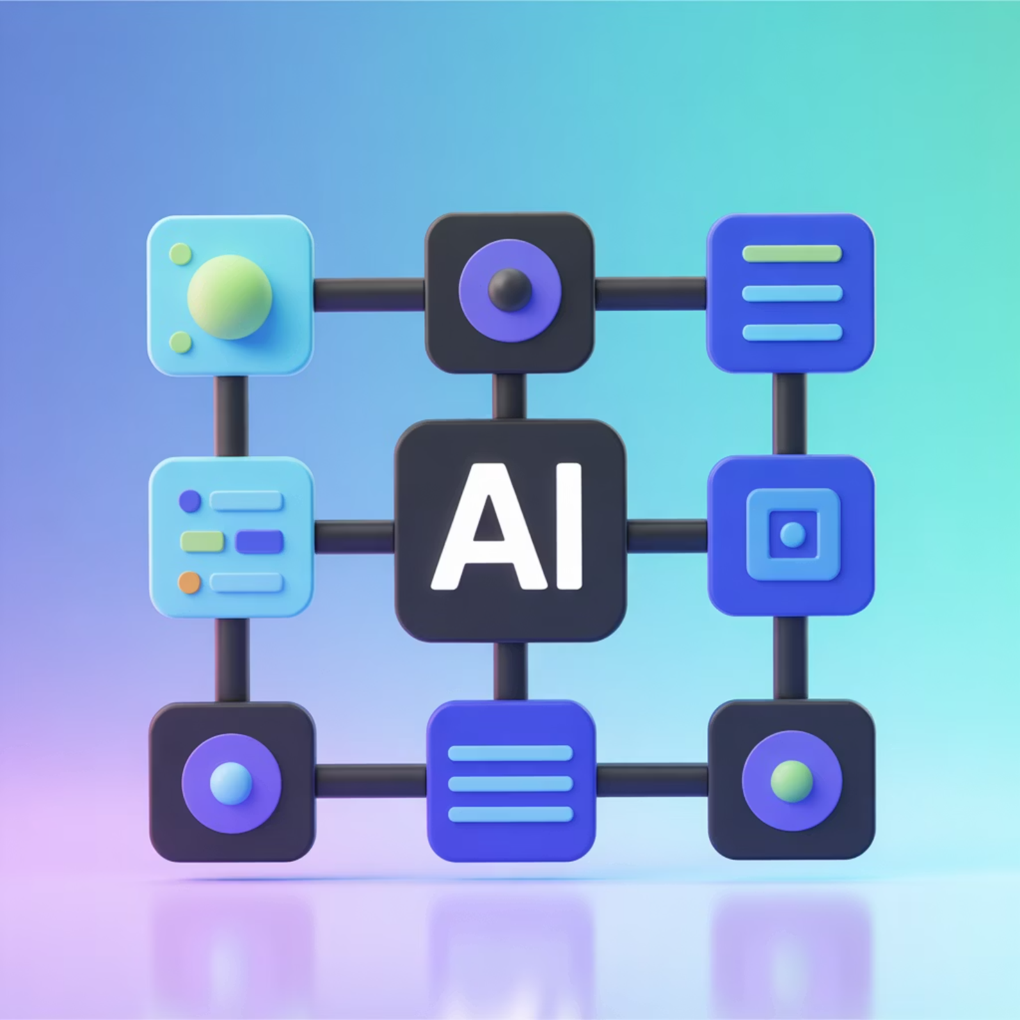
Building Production RAGChat Systems
Essential System Components
Orchestrator: LangChain or LlamaIndex serves as the glue coordinating all components
Vector Database: Pinecone, Milvus, or Weaviate stores embedded knowledge for semantic search
The Model: Llama-3 processes retrieved context and generates coherent responses
Evaluation Layer: LLM-as-a-judge systems verify output quality and factual accuracy
Evolution Beyond Q&A
Moving from simple question-answering to autonomous AI agents that check calendars, read emails, and draft contextual responses.

Slide 10

Ethical Challenges for AI Engineers
There was an error generating this image
There was an error generating this image
There was an error generating this image
Data Leakage Prevention
Hallucination Monitoring
Sustainability Considerations
Ensure private RAG data doesn't accidentally appear in public logs, training data, or cached responses
Implement LLM-as-a-judge systems to verify factual accuracy and detect confident misinformation
Balance the energy cost of running 70B parameter models locally versus cloud deployment at scale

